Slide 1
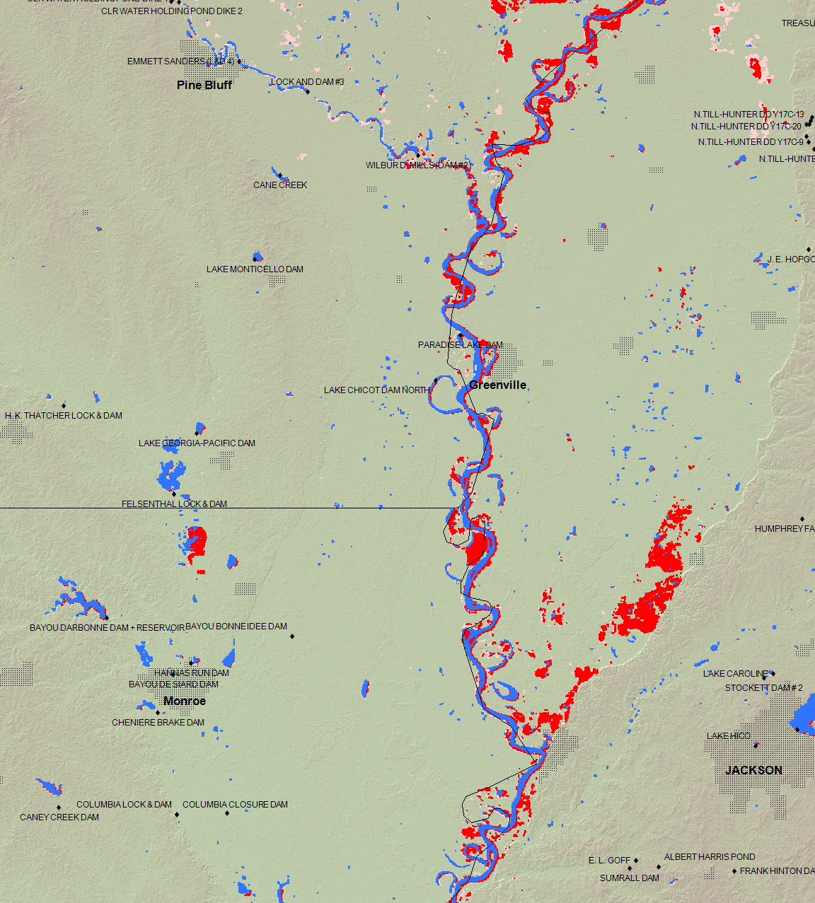
May 12-15, 2011
(red)
May 6-11, 2011
(light red)
Permanent Water
(blue)

Slide 2
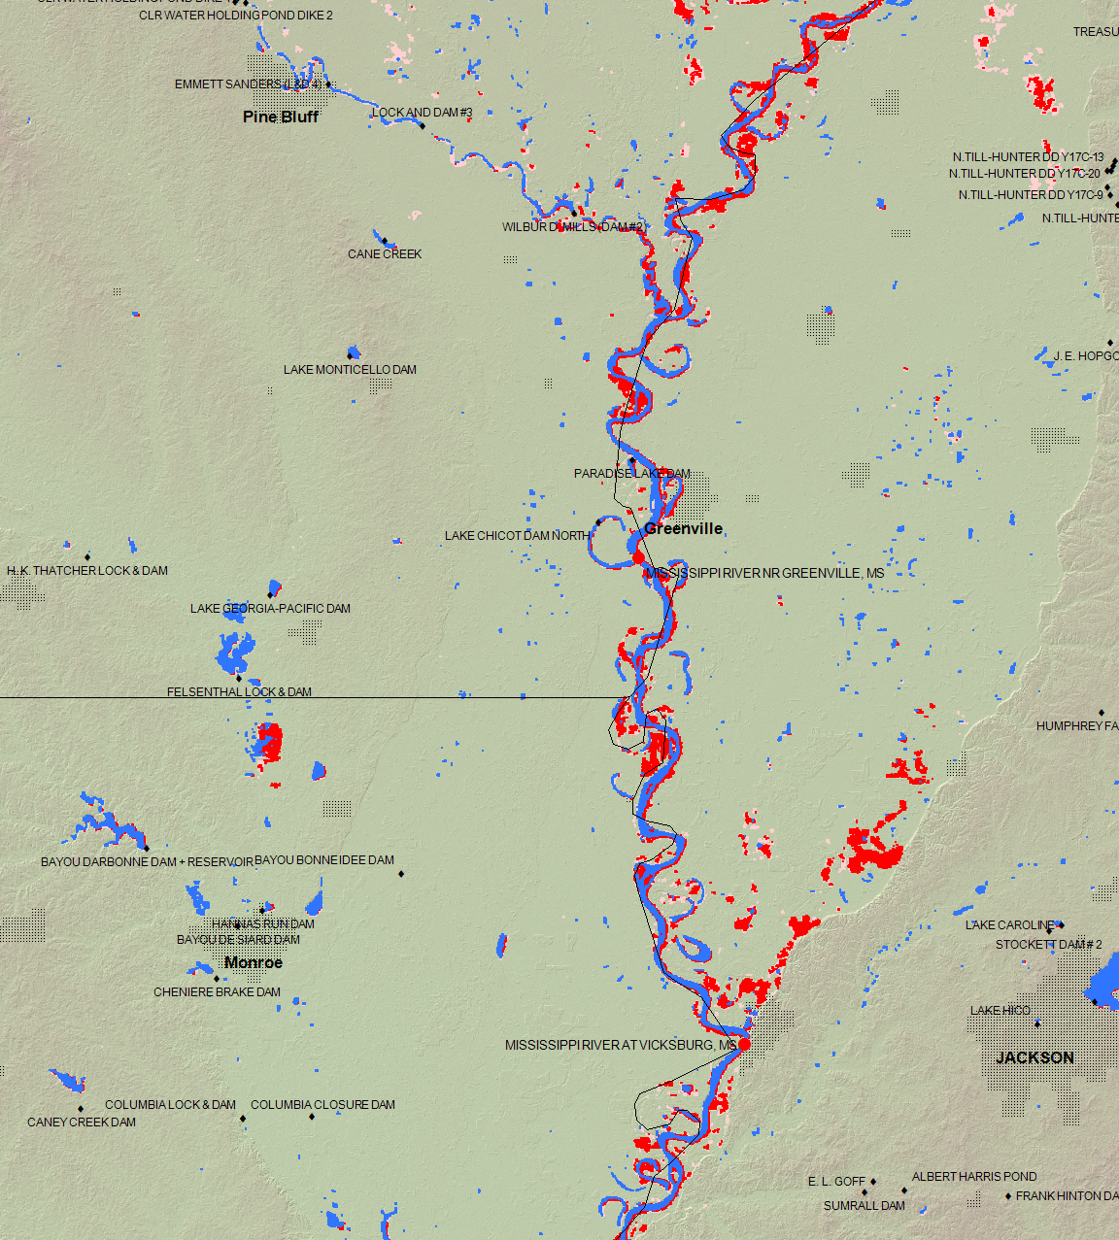
May 12-16, 2011
(red)
May 6-11, 2011
(light red)
Permanent Water
(blue)

Slide 3
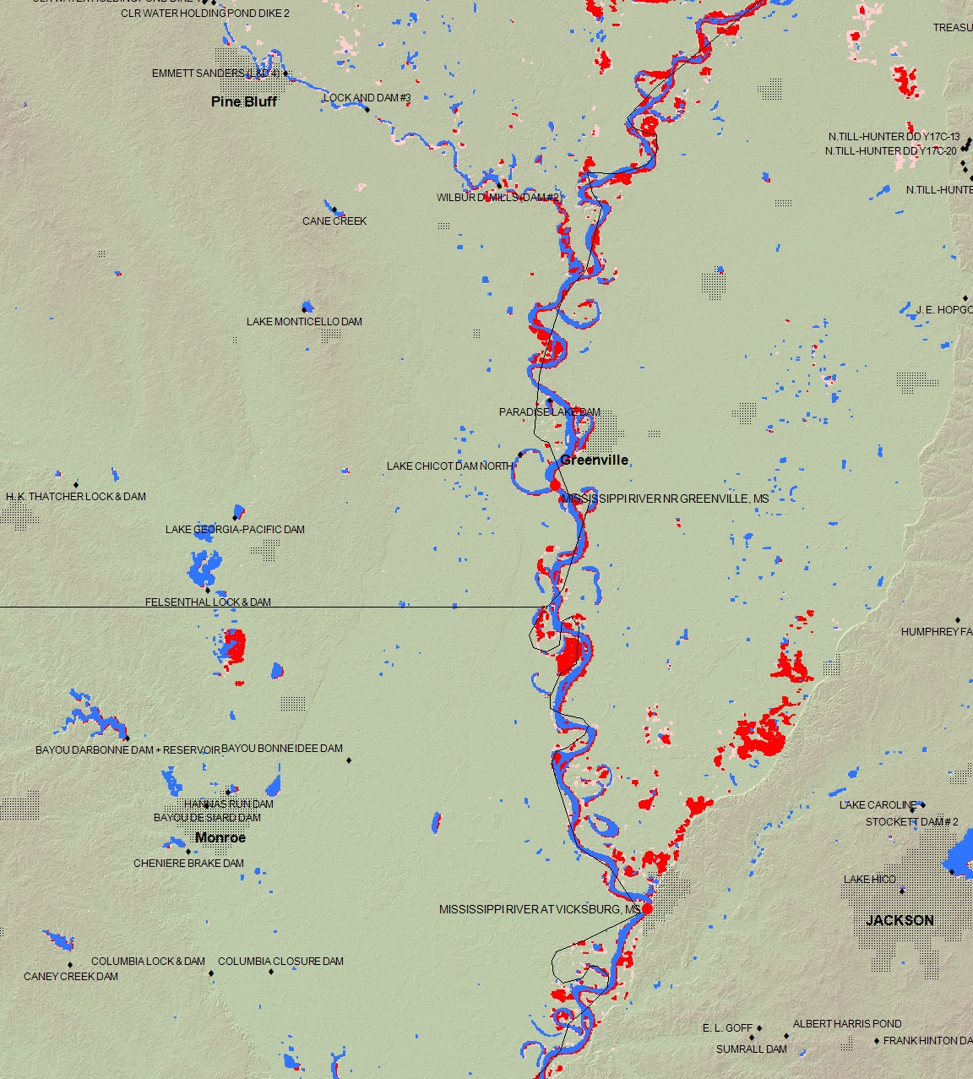
May 13-17, 2011
(red)
May 6-12, 2011
(light red)
Permanent Water
(blue)

Slide 4
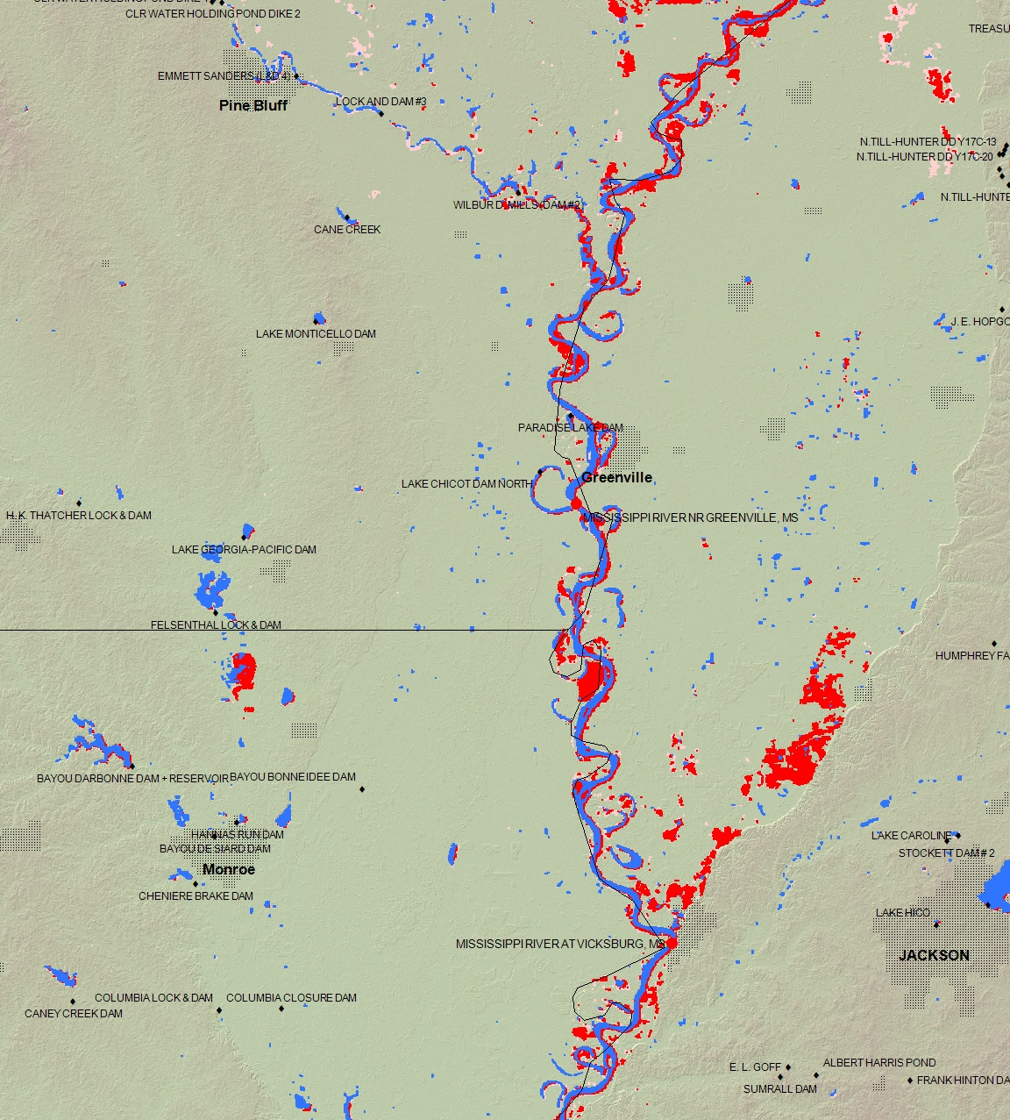
May 13-18, 2011
(red)
May 6-12, 2011
(light red)
Permanent Water
(blue)

Slide 5
May 13-19, 2011
(red)
May 6-12, 2011
(light red)
Permanent Water
(blue)

Slide 6
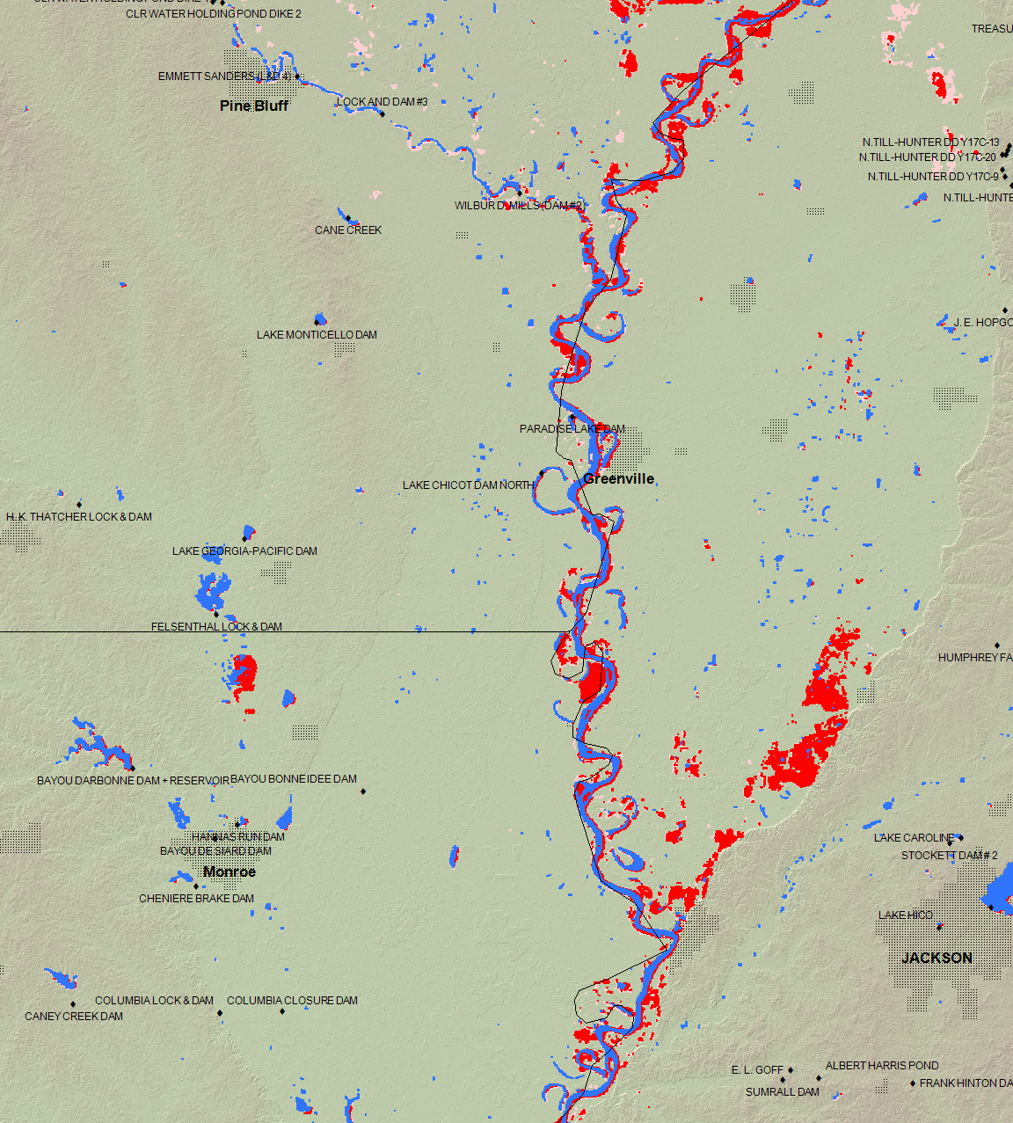
May 15-21, 2011
(red)
May 6-14, 2011
(light red)
Permanent Water
(blue)

Slide 7
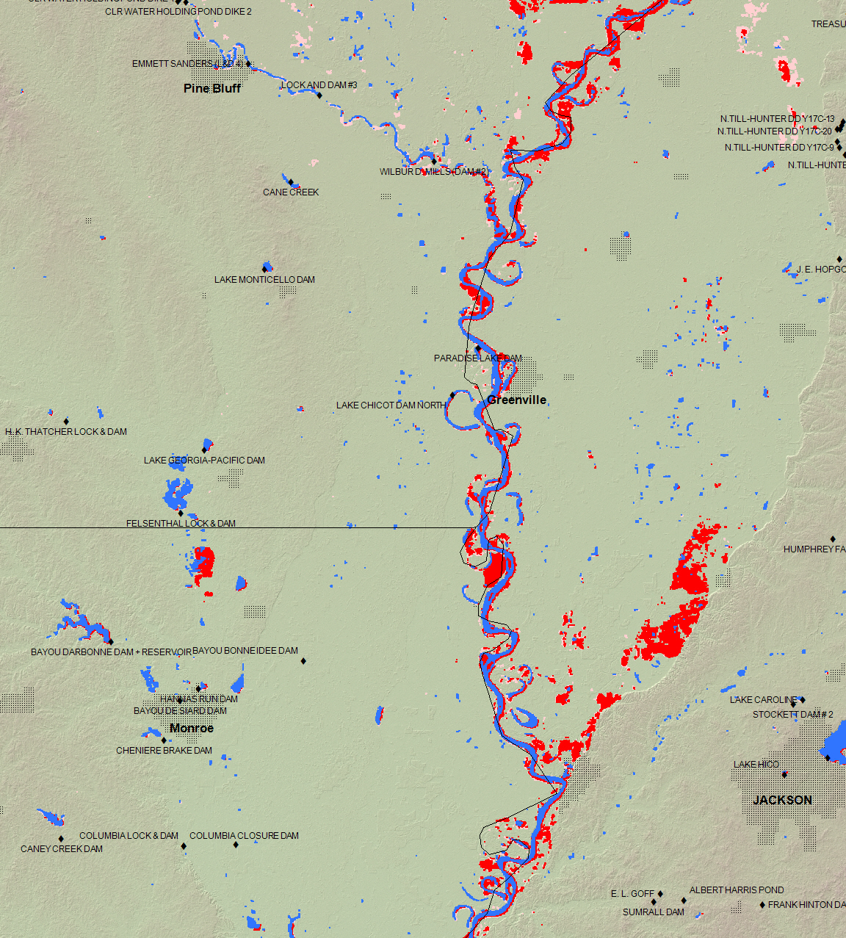
May 16-22, 2011
(red)
May 6-15, 2011
(light red)
Permanent Water
(blue)

Slide 8
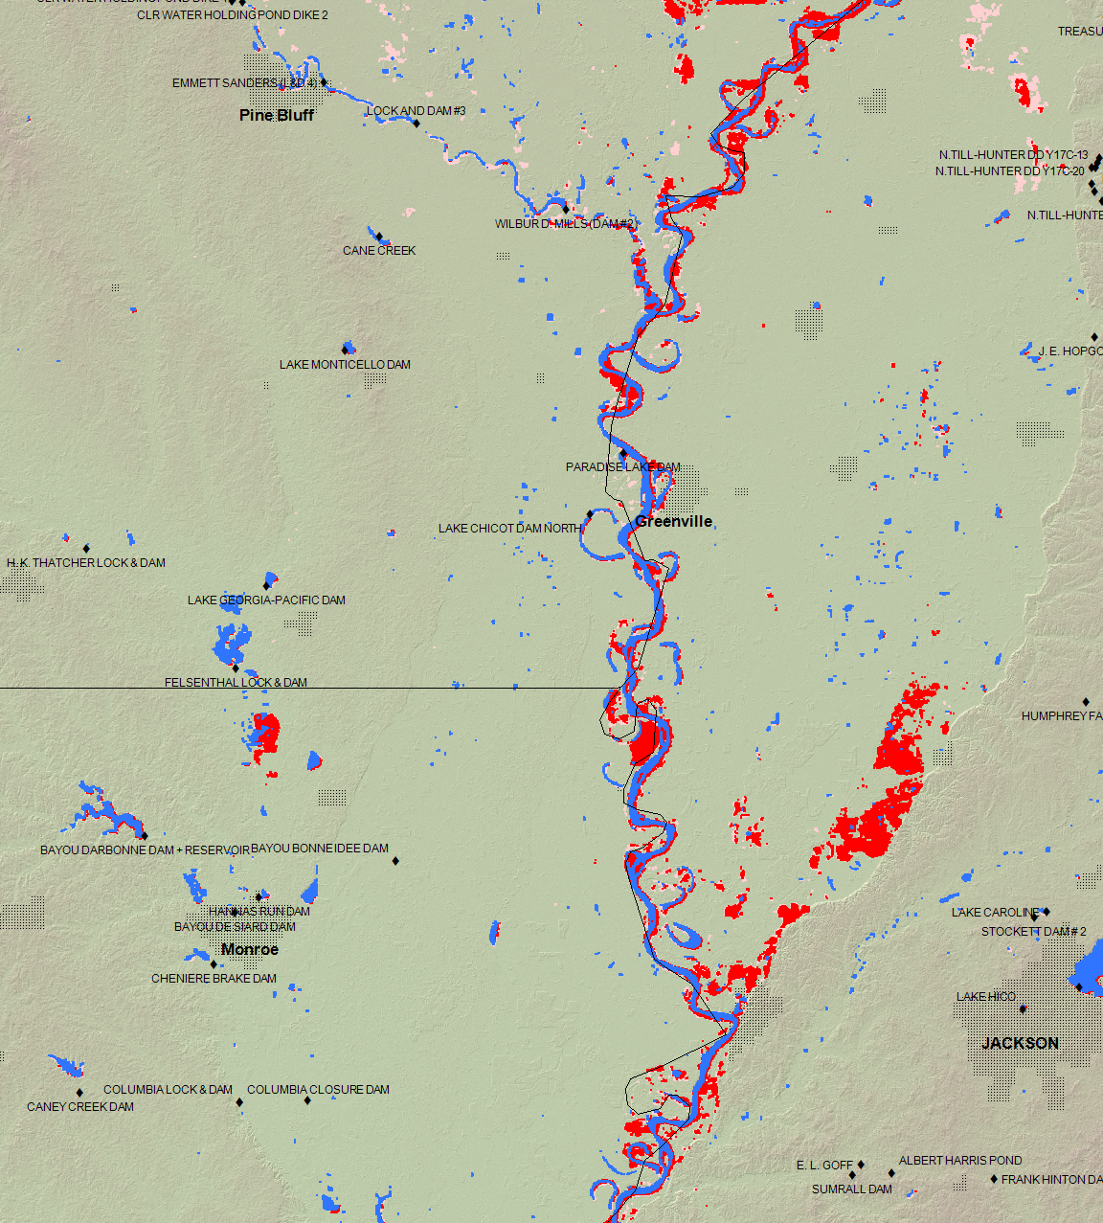
May 17-23, 2011
(red)
May 6-16, 2011
(light red)
Permanent Water
(blue)

