Slide 1
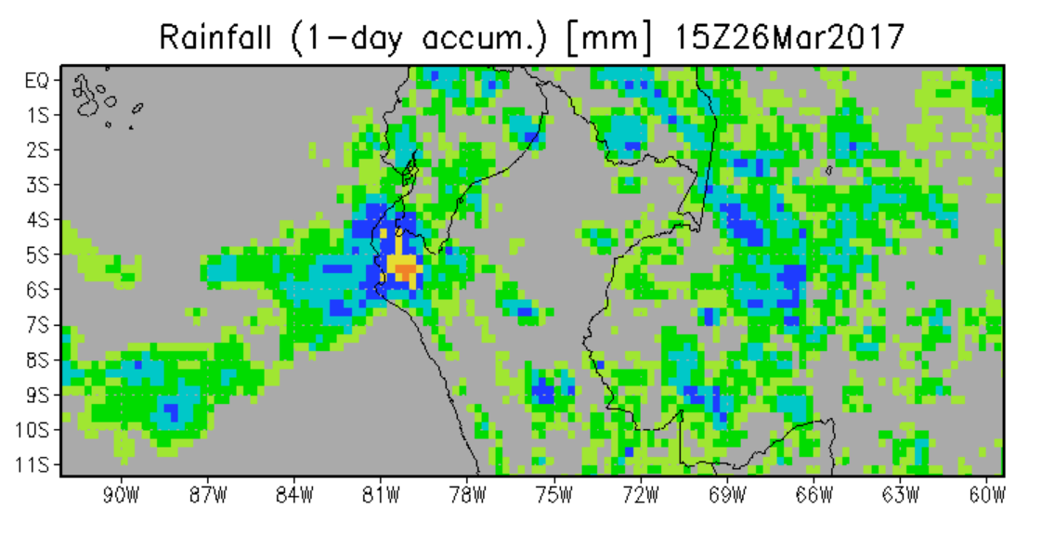
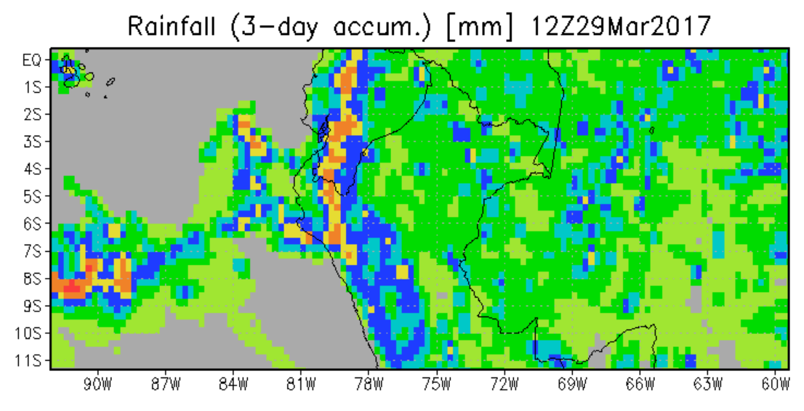
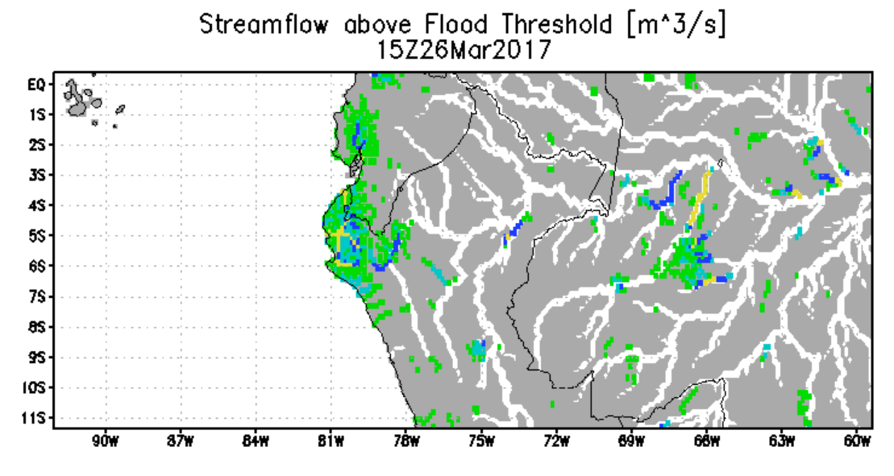
Peru Flooding—Status 26 March 2017
Satellite rainfall for last day
Forecast rainfall from NASA global model for next three days
Rain over the last day still concentrated in northwest Peru. Forecast rainfall for next three days from NASA GEOS-5 global model shows continued concentration in northwest (over 150 mm) and along coast to the south. The overview flood calculation from Global Flood Monitoring System (GFMS) [flood.umd.edu] today shows flooding still concentrated in the northwest—forecast flood maps on next slide.
Flood estimate for
26 March
GFMS (U. of Maryland) flood.umd.edu
R. Adler/U. of Maryland

Slide 2
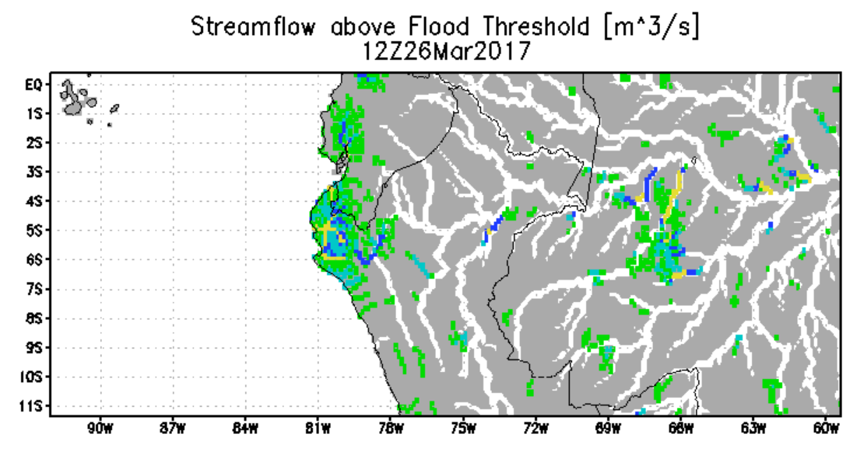
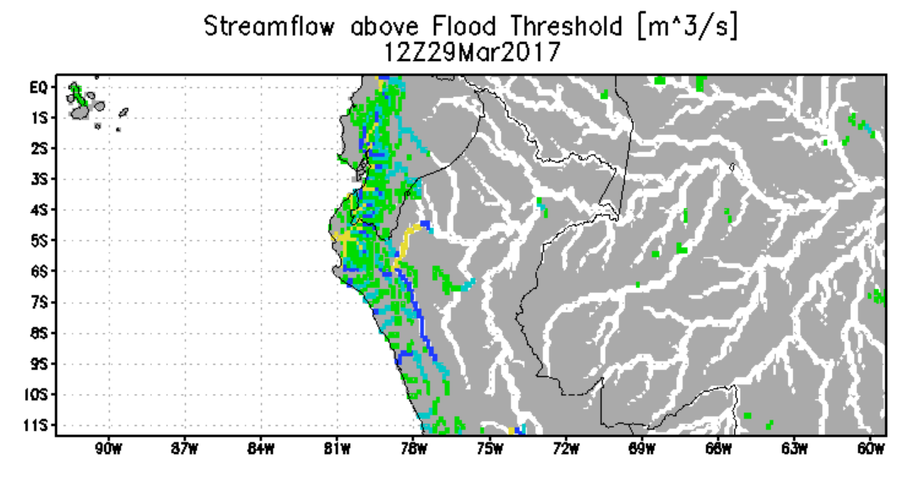
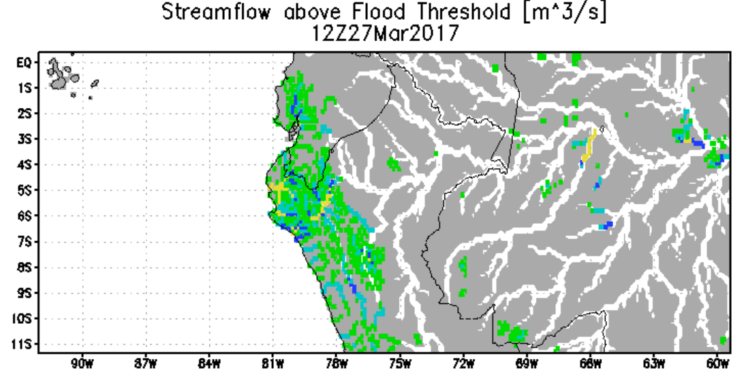
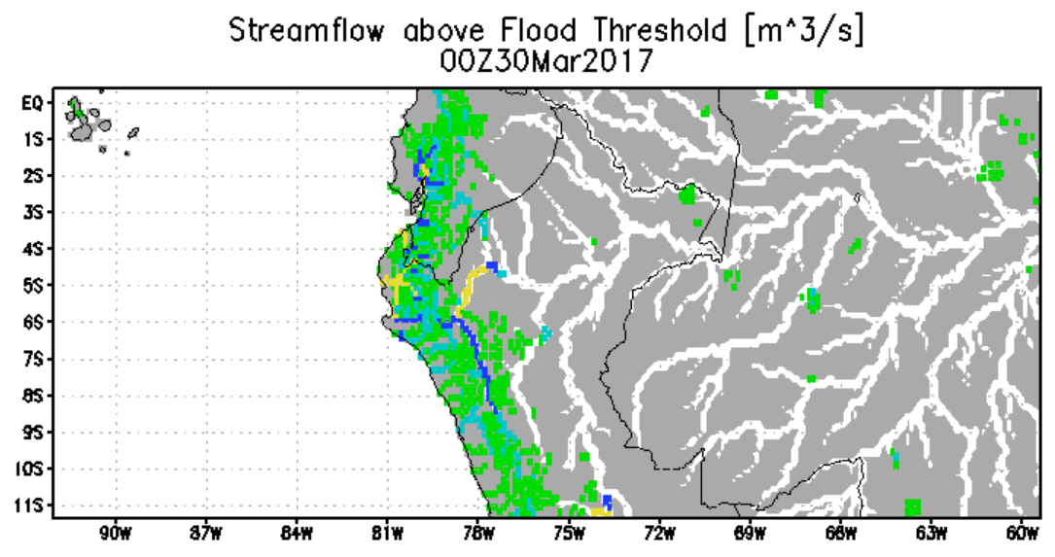
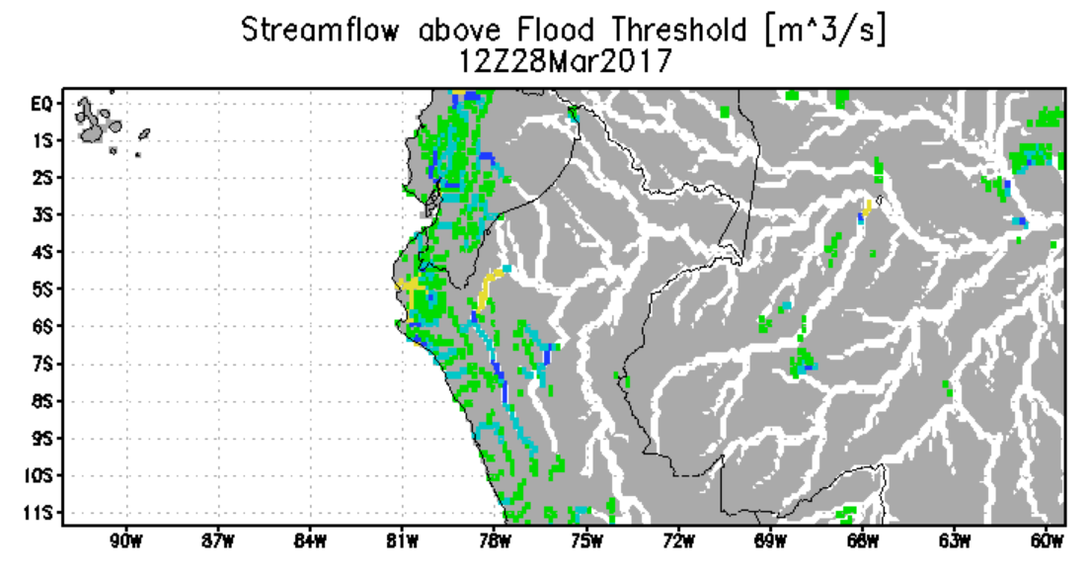
Forecast of Flooding (Streamflow above Flood Threshold) over 26-30 March

Slide 3
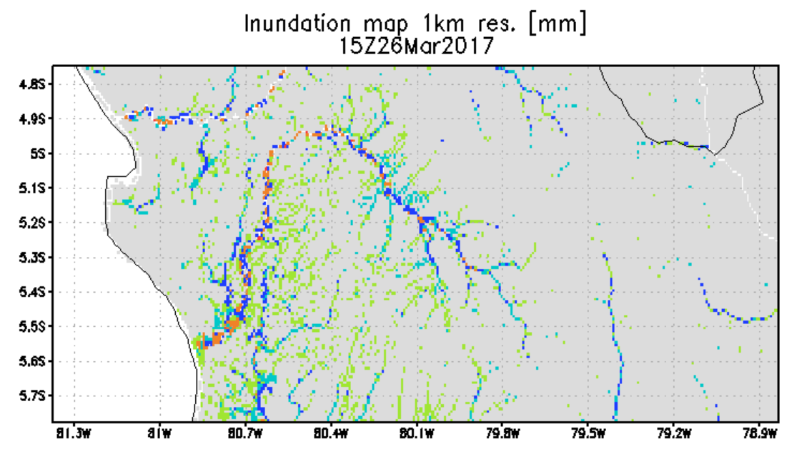
Inundation Estimate 26 March 2017
Chira River
Piura River
Calculated inundation map with water depth at 1 km resolution from GFMS
Piura X
GFMS (U. of Maryland) flood.umd.edu

Slide 4
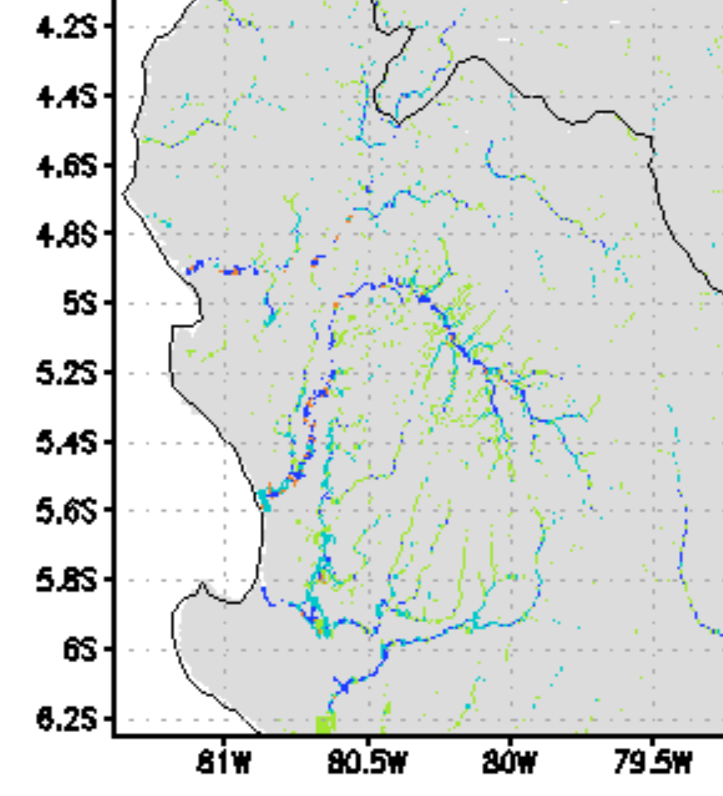
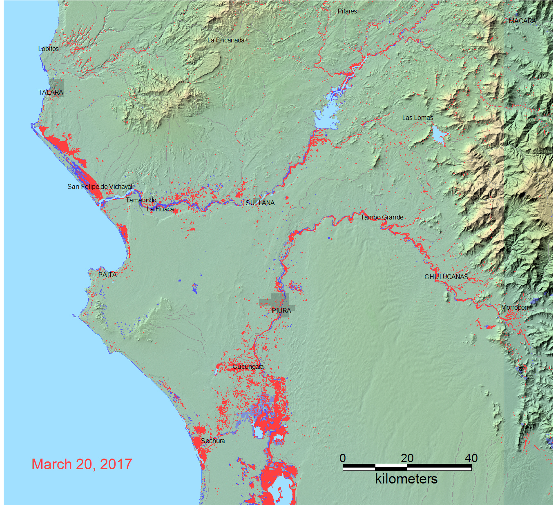
Comparison of Sentinel and GFMS Inundation Estimates
Flood Observatory (Brakenridge) Inundation Estimate from Sentinel 1 for March 20
GFMS Inundation Estimate (1 km) for March 20

Slide 5
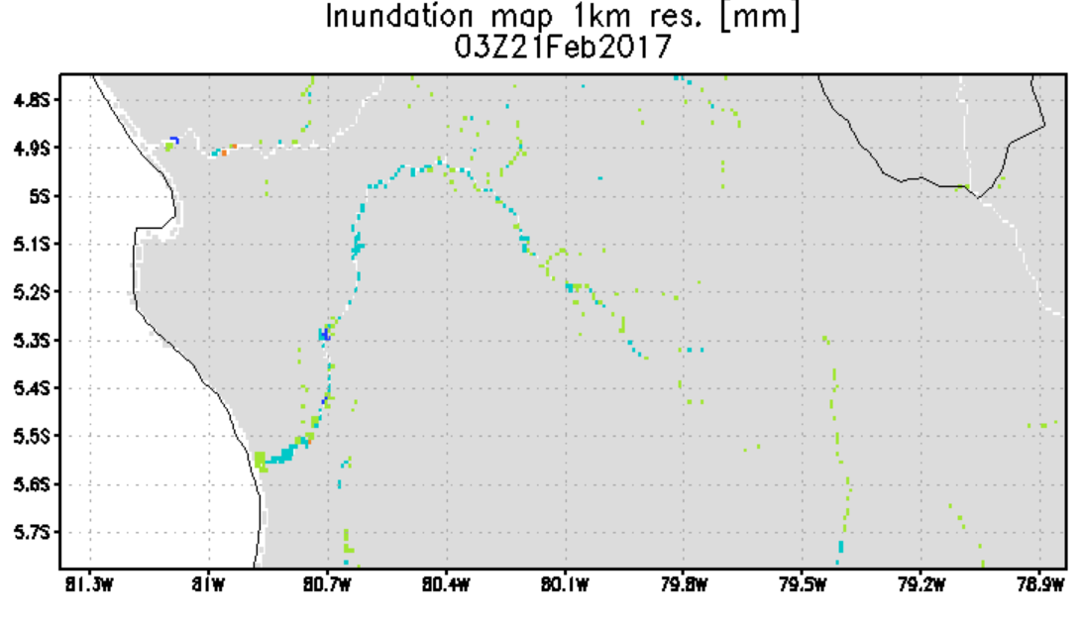
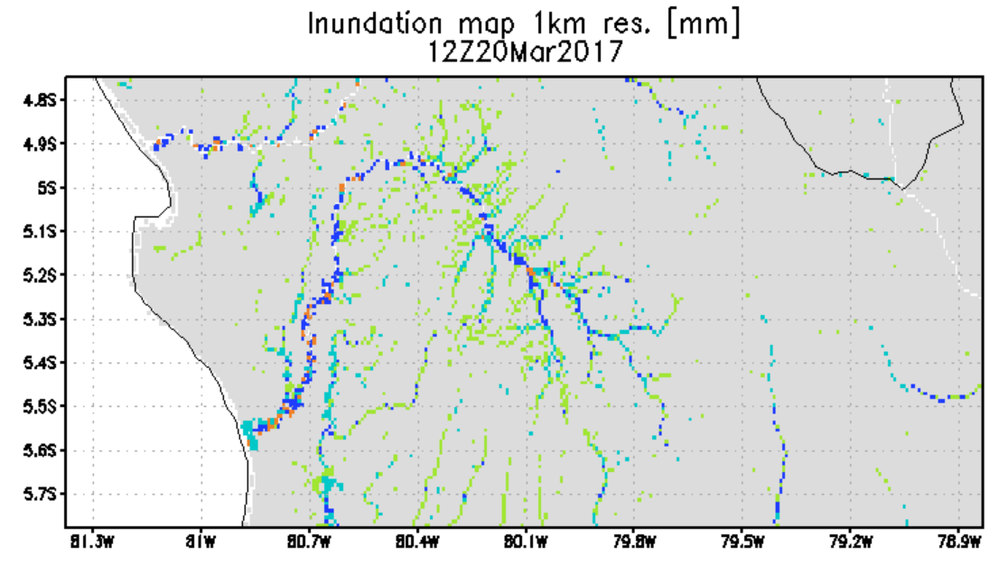
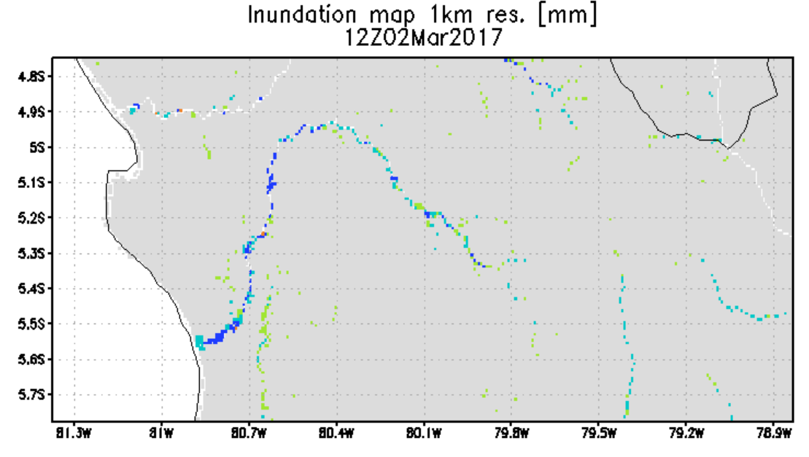
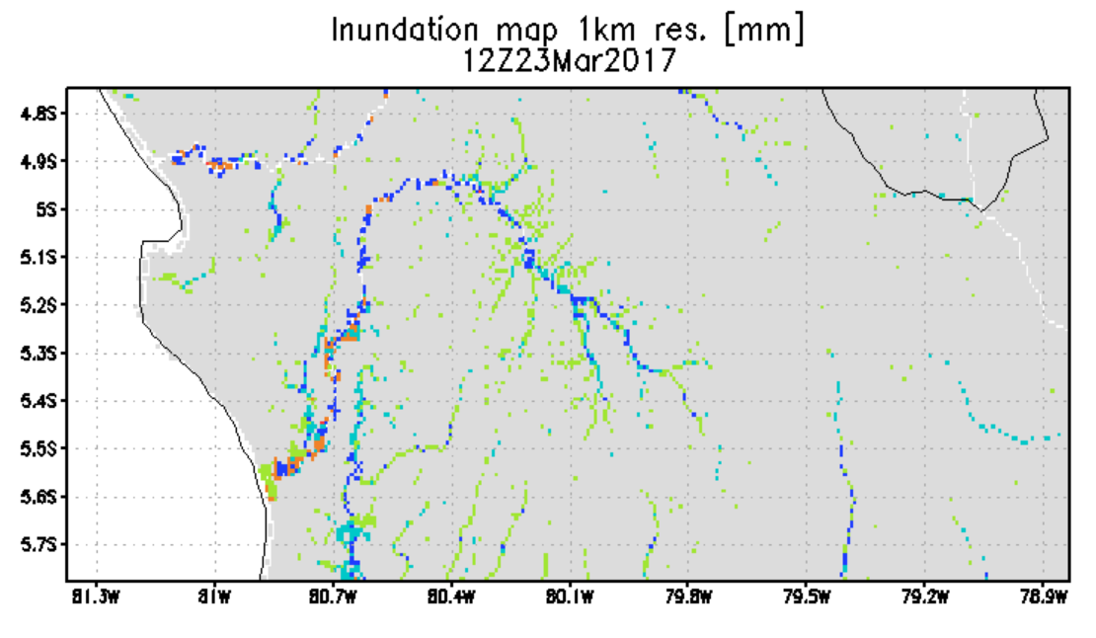
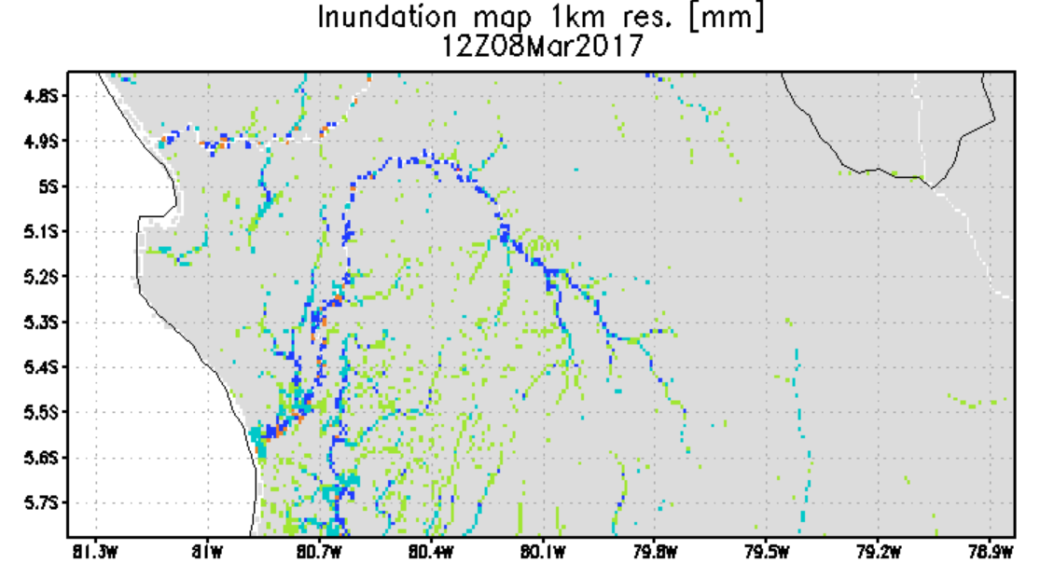
Evolution of Inundation Estimations—
Feb. 21 to March 26

Slide 6
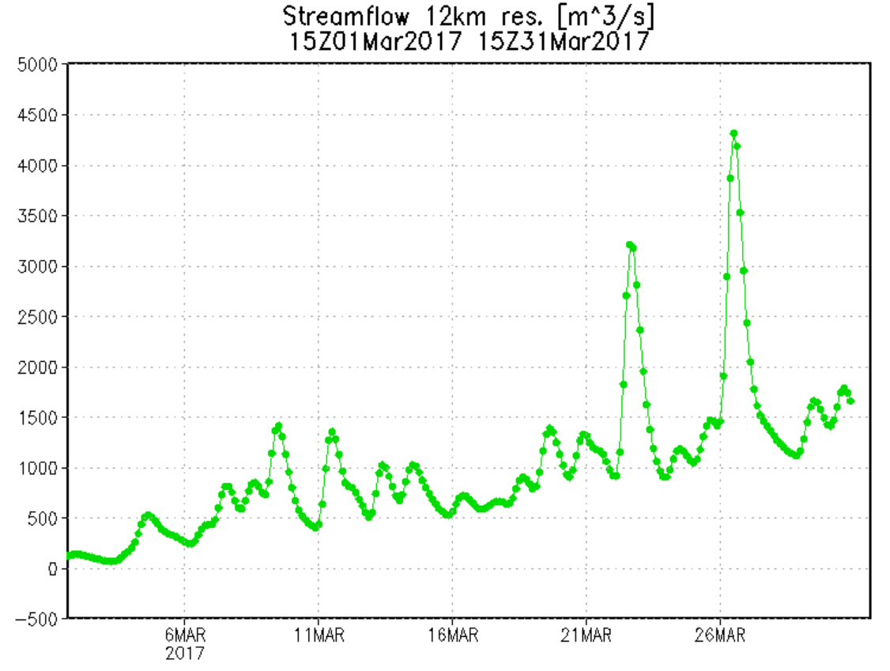
Estimated and Forecast Streamflow at city of Piura along Piura River
Streamflow at city of Piura (see location on a previous slide) hit new peak today. Forecast to drop quickly over next few days, although still above flood level. Lower bound of streamflow also gradually increasing all during March from near zero to 1500 cu. m/s.
Forecast ➔
Flood Threshold
GFMS (U. of Maryland) flood.umd.edu

