Slide 1
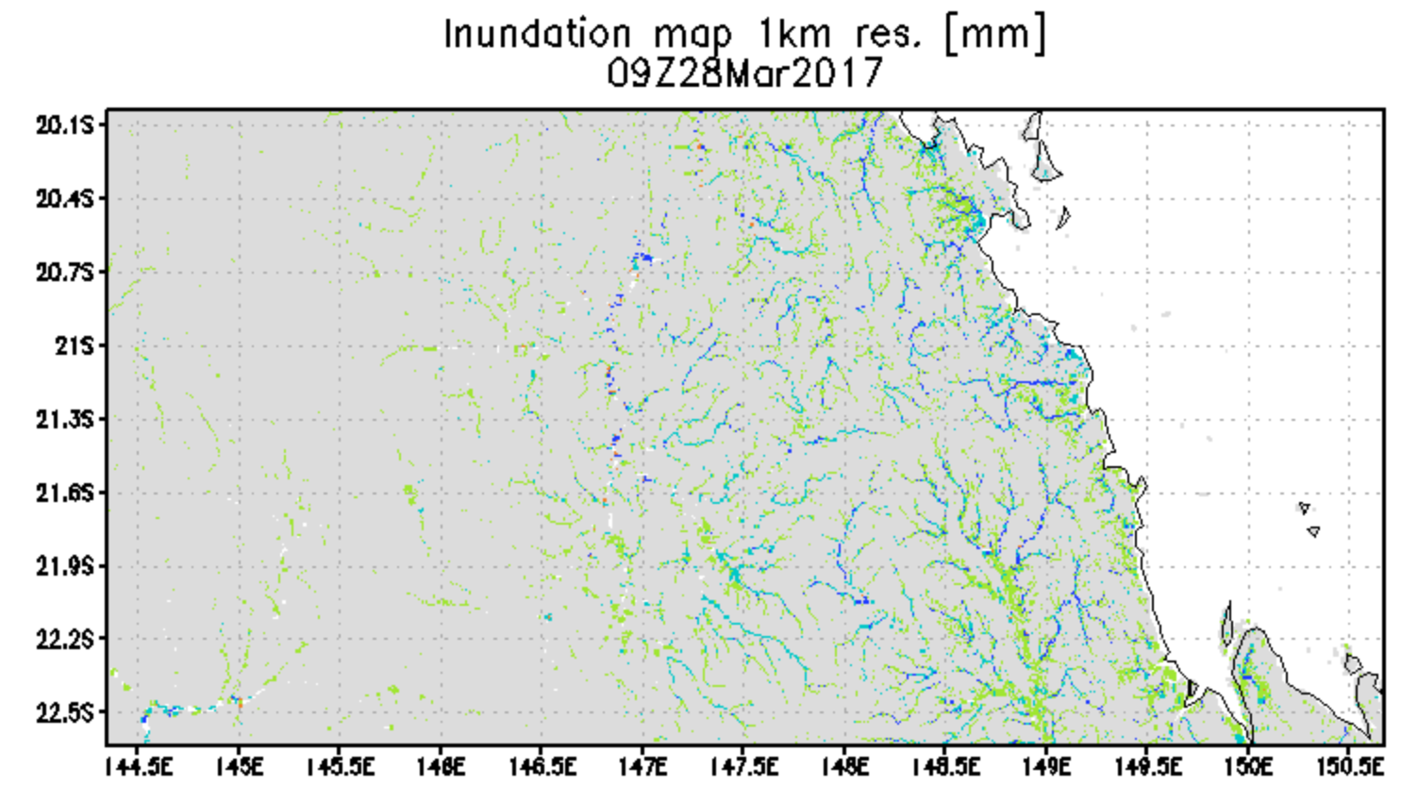
Inundation Estimate 28 March 2017
Calculated inundation map with water depth at 1 km resolution from GFMS
GFMS
(U. of Maryland) flood.umd.edu

