Slide 1
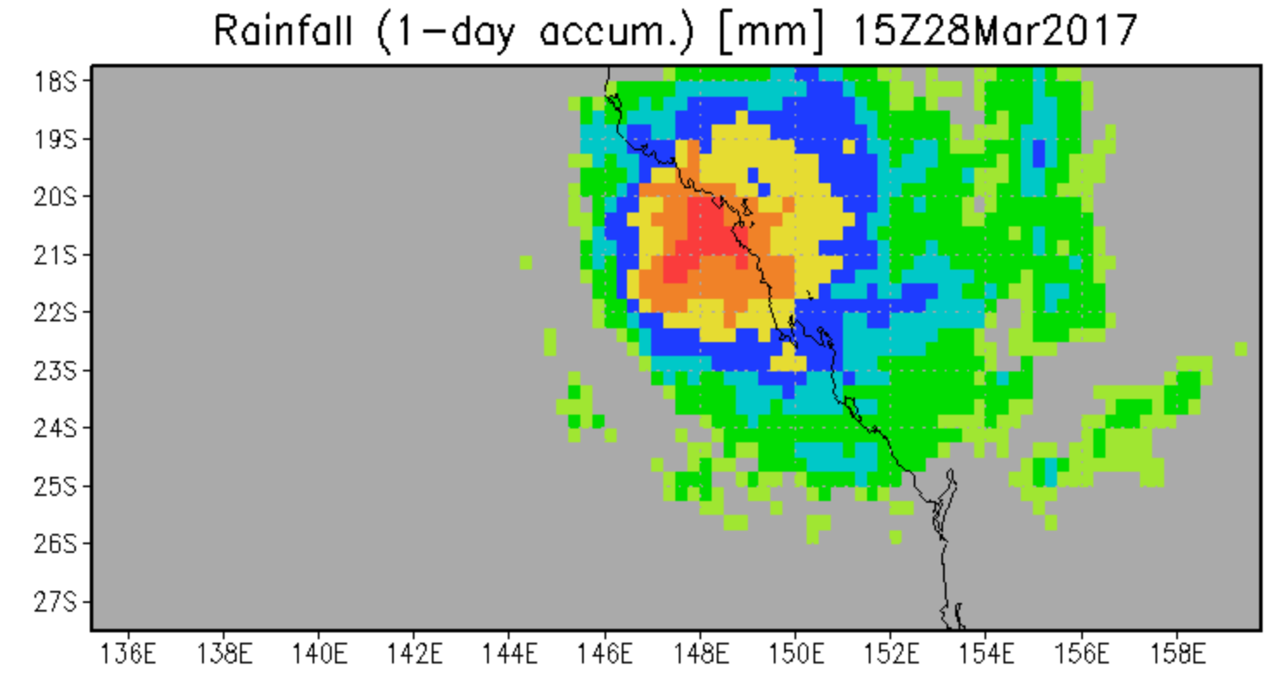
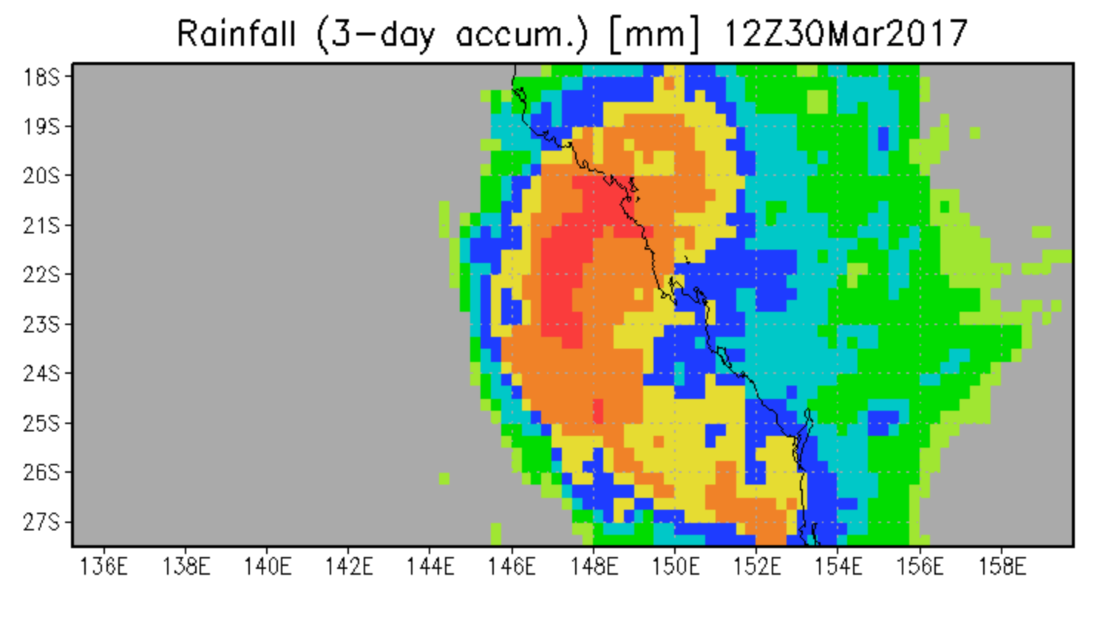
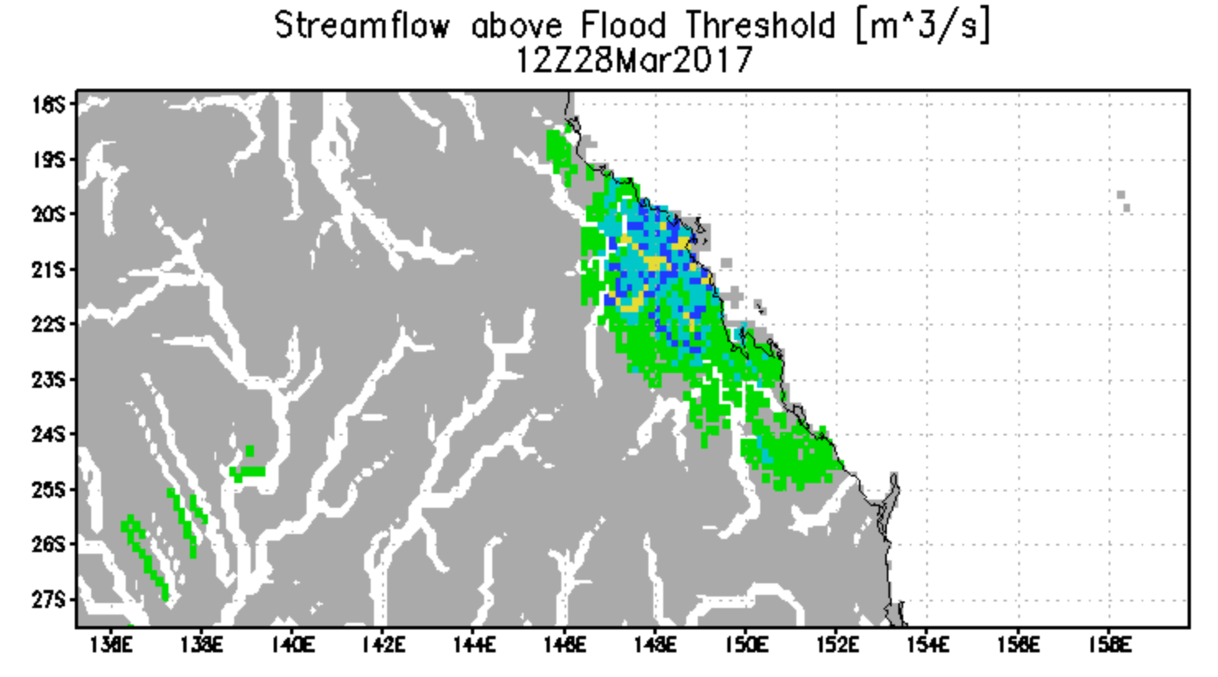
Australia Flooding (Cyclone Debbie) —Status 28 March 2017
Rainfall estimated and forecast for three days ending 30 March
Satellite rainfall for last day
Cyclone Debbie producing very heavy rain today and the next three days as it turns south. The overview flood calculation from Global Flood Monitoring System (GFMS) [flood.umd.edu] today shows flooding concentrated near landfall locations and further south—forecast flood maps on next slide.
Flood estimate for
28 March
GFMS (U. of Maryland) flood.umd.edu
R. Adler/U. of Maryland

Slide 2
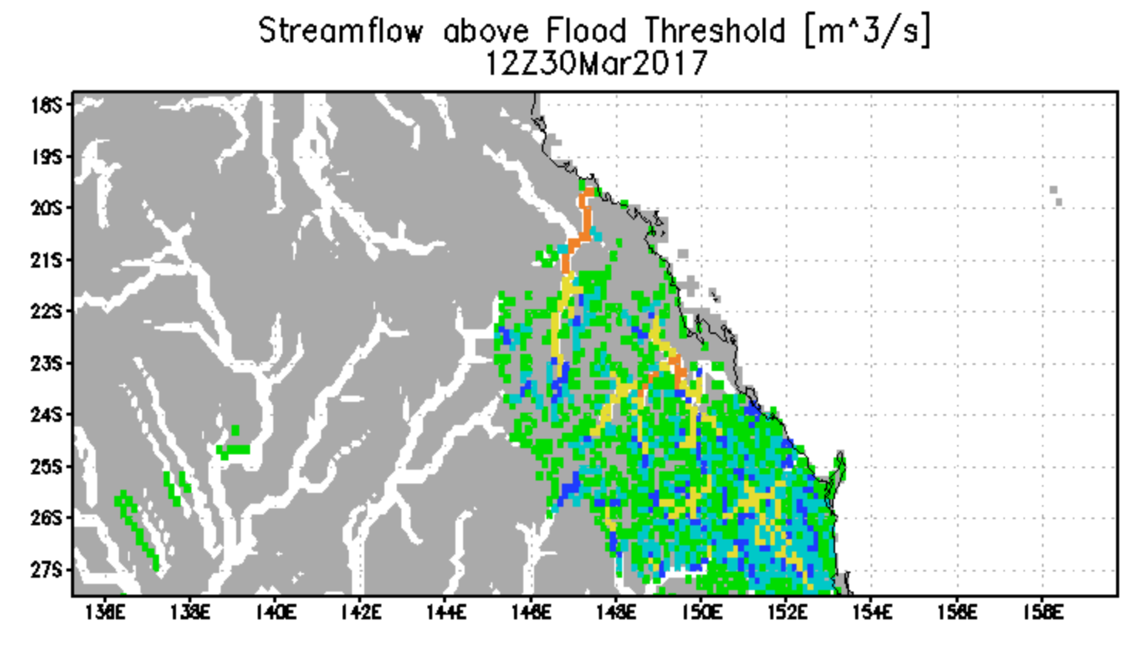
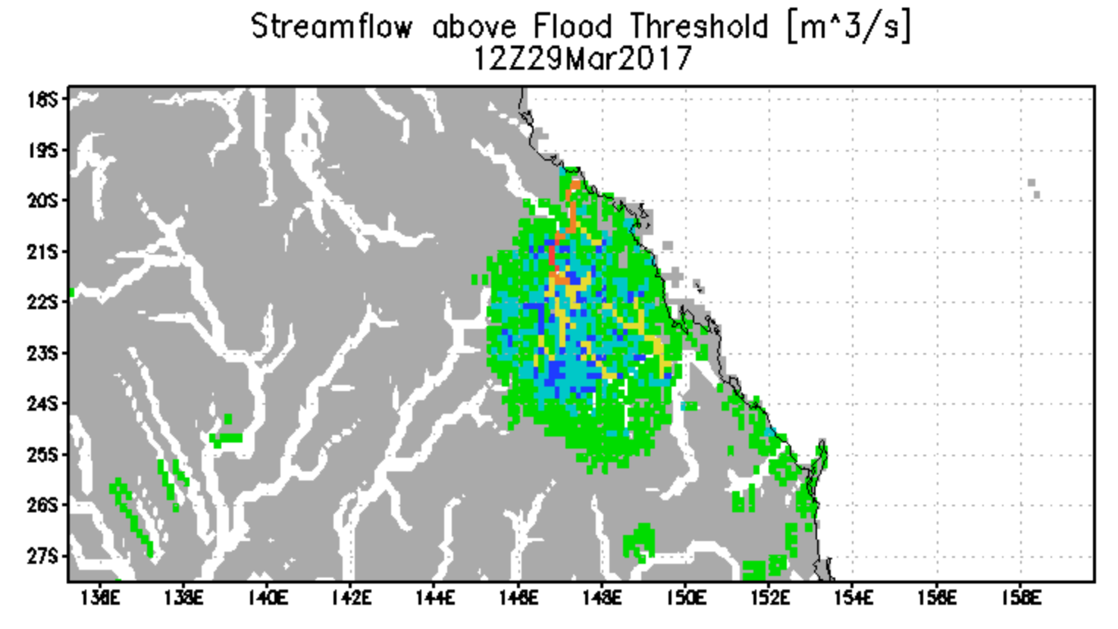
Forecast of Flooding (Streamflow above Flood Threshold) over 28-30 March

Slide 3
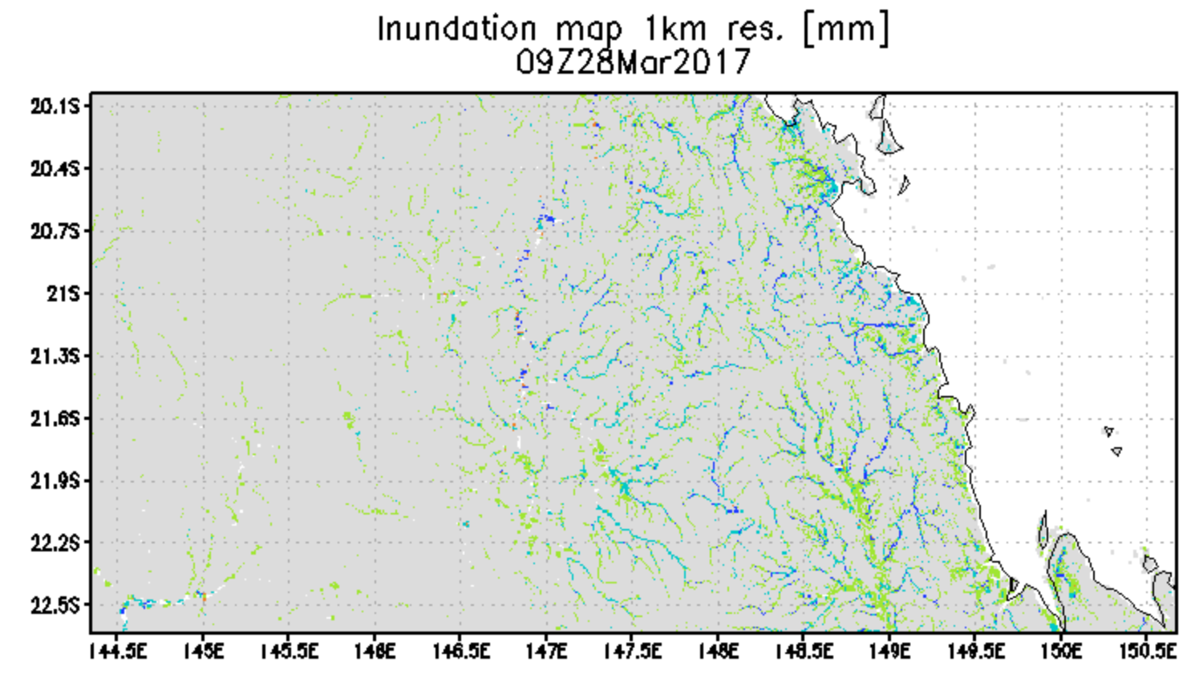
Inundation Estimate 28 March 2017
Calculated inundation map with water depth at 1 km resolution from GFMS
GFMS
(U. of Maryland) flood.umd.edu

Slide 4
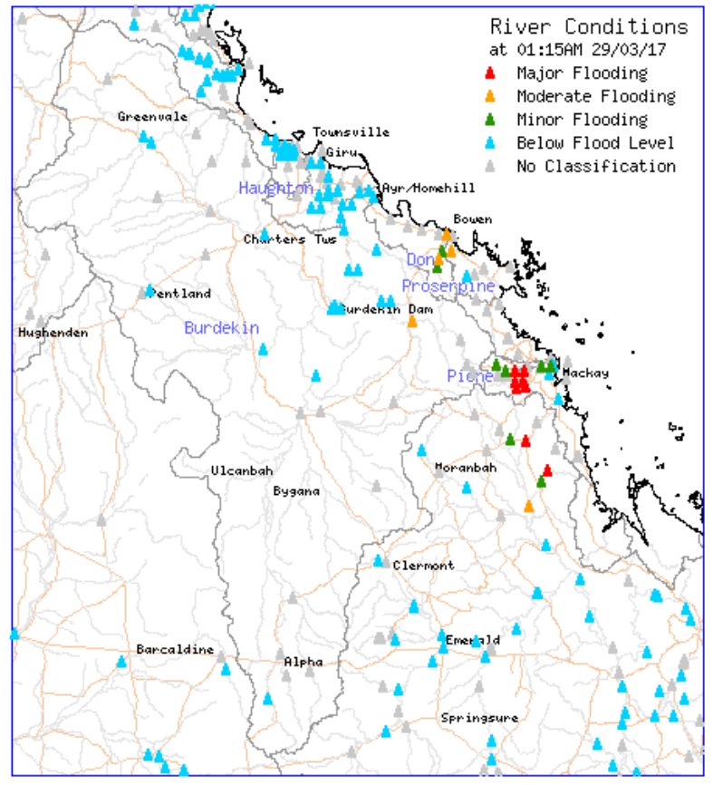
From http://www.bom.gov.au/qld/flood/central.shtml

