Slide 1
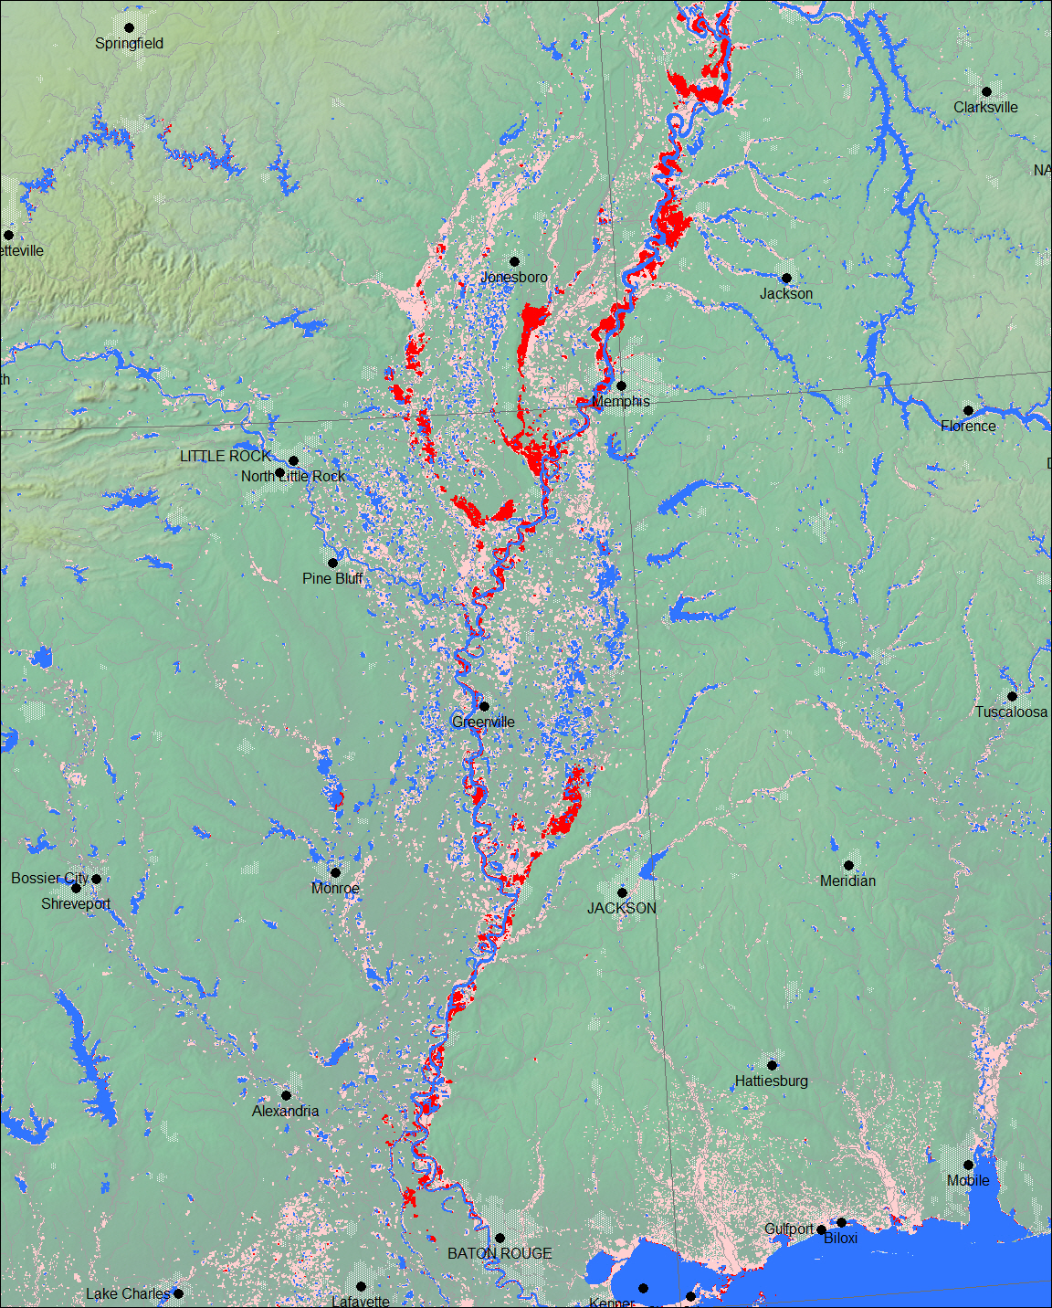
May 12-15, 2011
(red)
May 6-11, 2011
(light red)
Permanent Water
(blue)

Slide 2
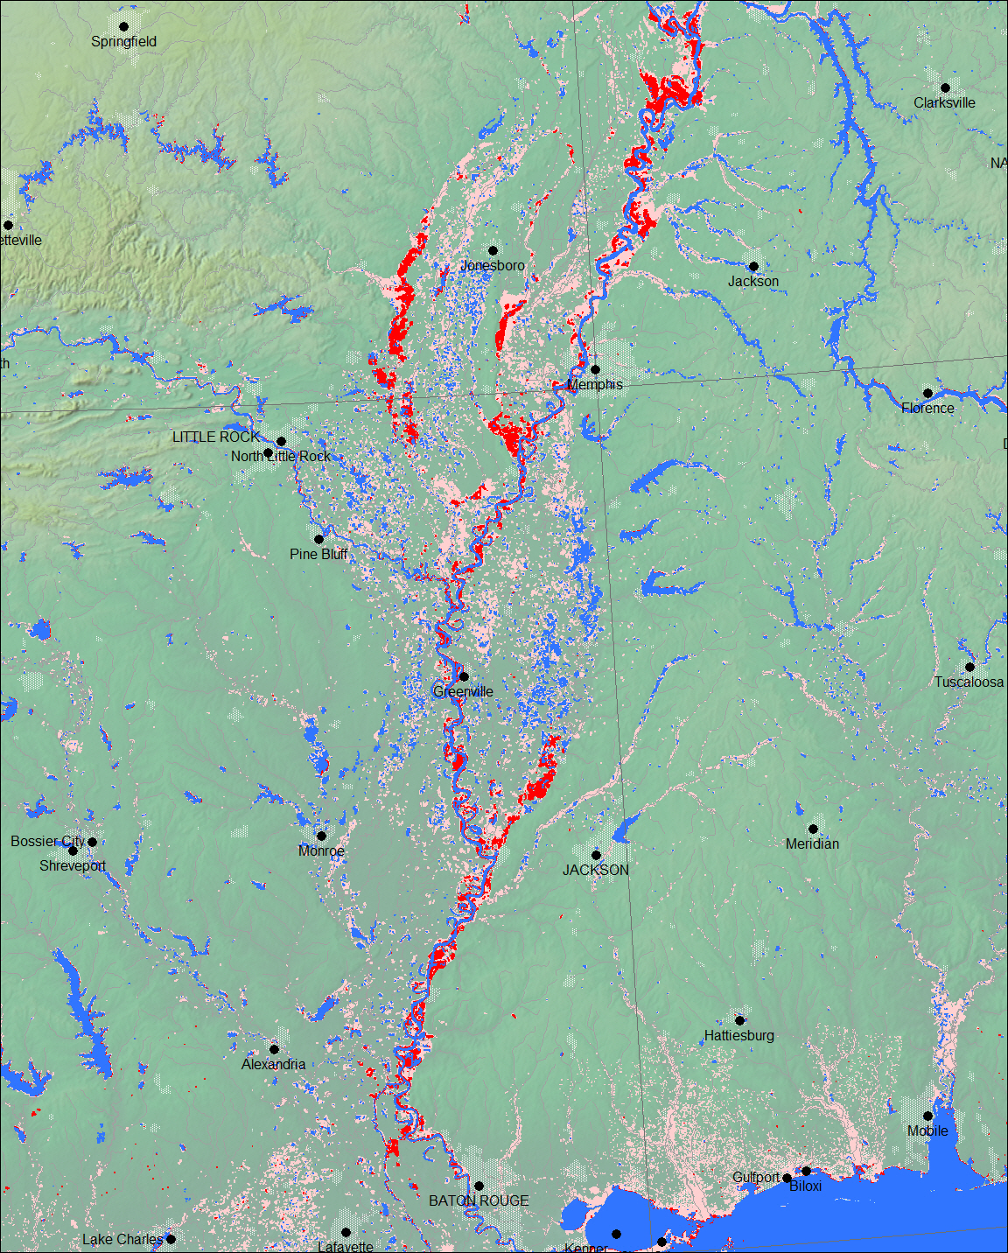
June 1-6, 2011
(red)
May 6-31, 2011
(light red)
Permanent Water
(blue)

